Slide 1
Is a Bachelor’s Degree
“worth it?”
TAKTical Tobi Andrade, Abdul Hashim, Kenneth Gonzalez,Tyler Sotomayor

Slide 2
Motivation & Summary

Slide 3

Core Message
A college degree is no guarantee of economic success, however does your choice of college major increase your chances of boosting these odds?
How big of a financial difference can your choice of major make?

Slide 4

Questions we asked, and why?
What are the 10 highest paying degrees?
What are the 10 lowest paying degree?
Which degrees have the biggest gap between men and women?
How does the expected median salary of a particular degree compare with the average salary in the United States?
Which college degrees have the largest number of graduates working in a job that a college degree is not needed?

Slide 5
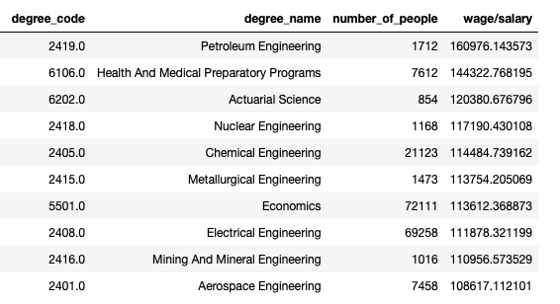
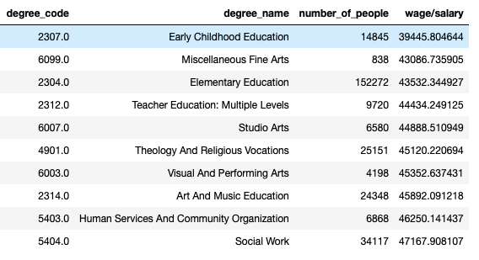
Summary of Findings for Q1 & Q2

Slide 6
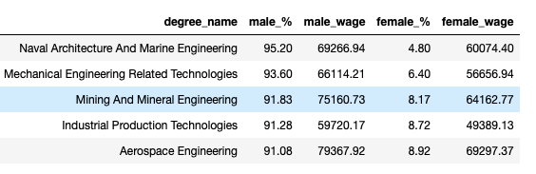
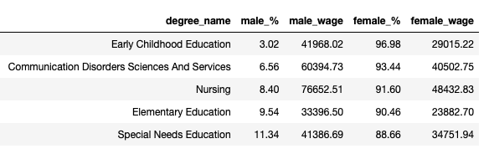
Summary of Findings Q3

Slide 7
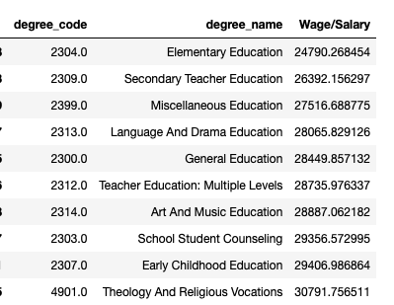
Summary of Findings Q4
Average US Salary from 2013 - 2017
$47,016

Slide 8
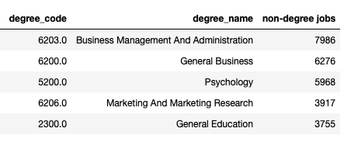
Summary of Findings Q5

Slide 9
Questions & Data

Slide 10
What are the 10 highest/lowest paying degrees
What data was needed?
Where did we find the data?

Slide 11
Which degrees have the biggest gap between men and women?
What data was needed?
Where did we find the data?

Slide 12
How does the expected median salary of a particular degree compare with the average salary of the US?
What data was needed?
Where did we find the data?

Slide 13
Which college degree has the largest number of graduates working in a job that does not require a college degree?
What data was needed?
Where did we find the data?

Slide 14
Data Cleanup & Exploration

Slide 15
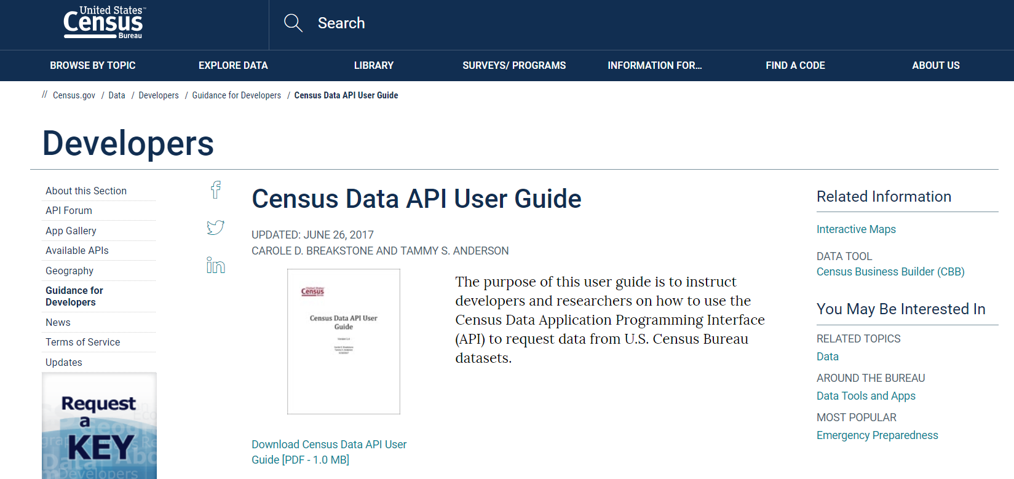
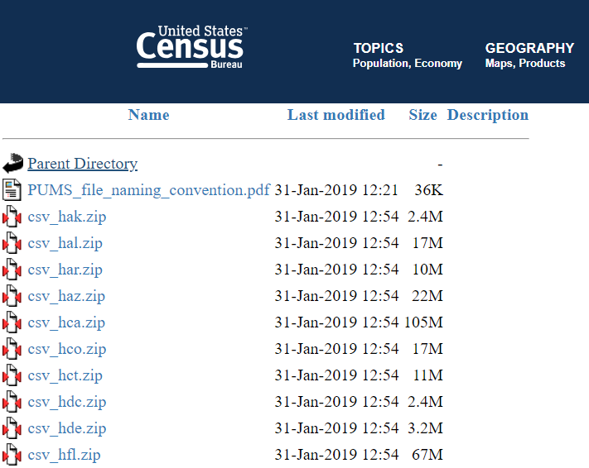
Data
US Census Data API
Great documentation
Great amounts of data
A giant mess of data keys
US Census American Community Survey
Public Use Microdata Sample(PUMS)
Large amounts of downloadable data
Good dictionary of values in a .pdf
Notes:
We asked ourselves : What is the best place to get labor data? ……..The US Census! The US Census Bureau has a great API for looking at surveys done in the whole country
That is a lot of data that we could go through, but in general, It is too broad
It also has them documented with URLS and query variables(there are alot of them and they are coded)
So we kept looking and Kenneth found the PUMS Data which contains large amounts of data for every state in the whole usual that includes more specific which we wanted.
And it includes a Dictionary file with all the column headers of the CSVs and what all the values mean.

Slide 16
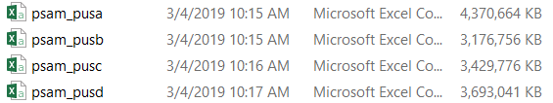
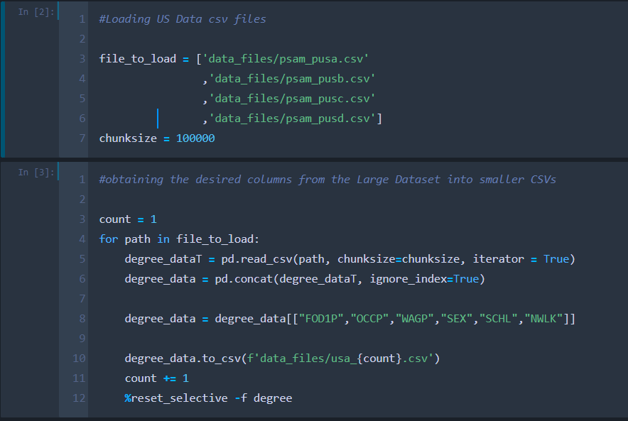
United States Data Cleanup
Whole US Data file is not small
It is even worse than we thought when we unzipped
We wanted get everything into a pandas dataframe.
This is how you get a memory error.
So it had to be broken down.
Notes:
The Data files for the whole US are not small at all. And they get much bigger once you actually get the csvs out
I thought hey, it will probably work but take a while to convert into a dataframe. I was so wrong!
So we had to break the files down to what we needed to get that dataframe to manipulate.
In the code to the right I, made a list of the paths to the files and the used a read_csv feature called chunksize which breaks down how much of the file it is reading at a time.
And then added every line read into a database
Collected the columns we needed from the database using the dictionary codes and converted it into a csv
The last line resets all the variables that have degree in the name, which means I do not have to worry about running out of memory

Slide 17
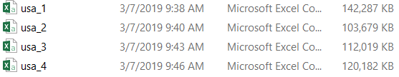
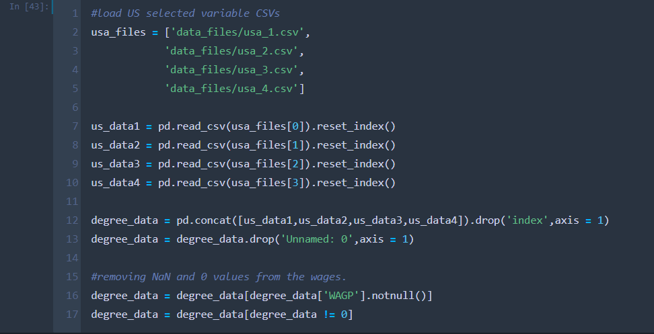
United States Data Cleanup
Output becomes these 4 smaller files
Something we can manage now
These files are then read into a Pandas dataframe and concatenated
Ending with deleting extra rows that do not have the information we need.
Total Lines (People with Degrees) : 13060960
Notes:
We went from 13 plus gigabytes of data to sort through, to only about half a gig
Now these files we can turn into dataframes and combine together to get all the information ready for analysis
With a total of 13 million lines of data or people if you will

Slide 18
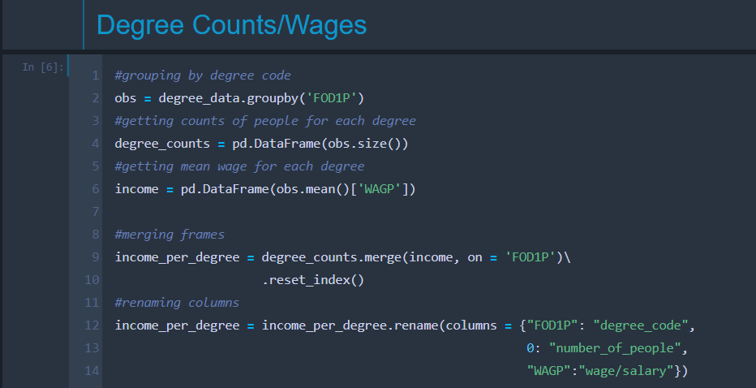
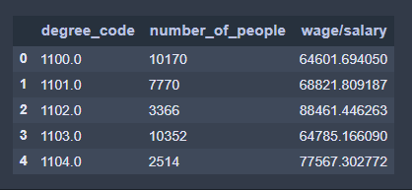
United States Data Exploration
Here is an example of gathering the data we need together.
Grouping by Degree Codes
Taking .size() to get counts for each degree
And taking a mean for each degree
Changing Column names respectively
This is the .head of the dataframe
It includes degree_codes
Notes:
Now that we have a dataframe with useful information, we got aggregate data for each degree
We grouped each degree, took the count for each degree and the mean salary for each degree
Then we can display the information we have found

Slide 19
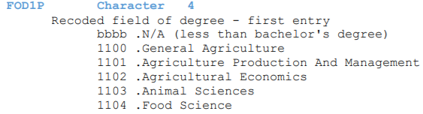
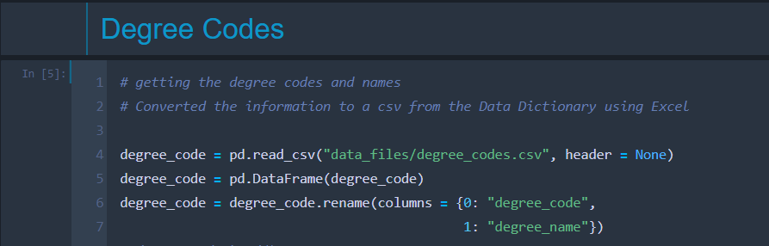
United States Data Exploration
What are the codes?
Codes are linked to a degree and occupation names
The PUMS Data Dictionary
Has all the column names and variables listed by code
Notes:
You can see that there are weird numbers or letters and columns we use, we got these from the PUMPS documentation
I converted the codes into a csv by copying the text into an excel file and delimiting
These files are then read into the code to create a datadrame of codes and names that can be merged with the rest of the data.

Slide 20
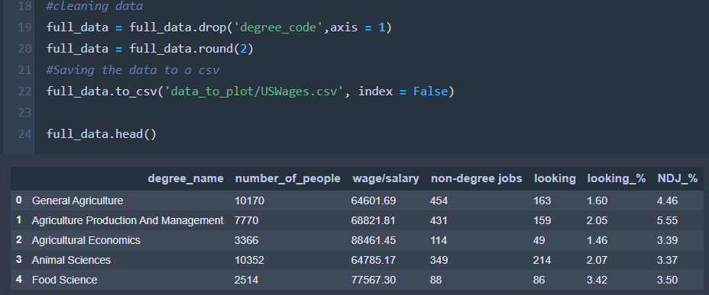
Data Ready For Shipping
The code and degree name have been merged
Dropping degree code
We have information per degree:
Number of people
Mean wage
People in non degree jobs
People looking for jobs
% of people looking for jobs
% of people in non degree jobs
Notes:
Now that we have the data organized we way we want to. We can merge frames together and print to a csv that we can use to plot things with.
This csv has all these columns per degree:

Slide 21
Data Analysis

Slide 22
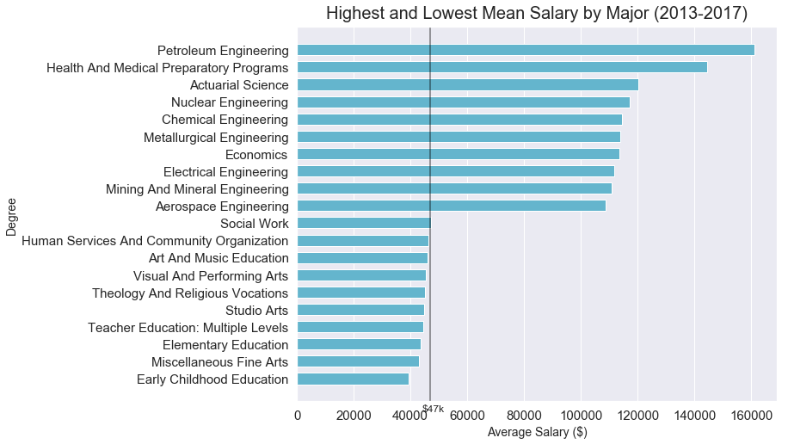

Slide 23
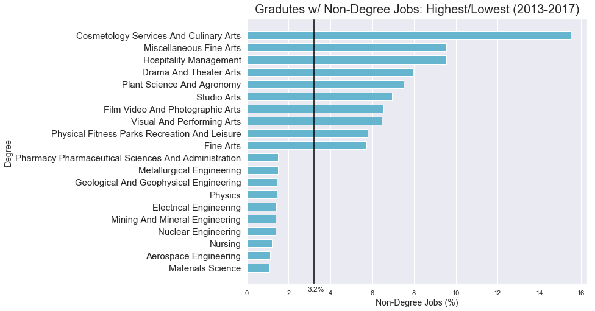

Slide 24
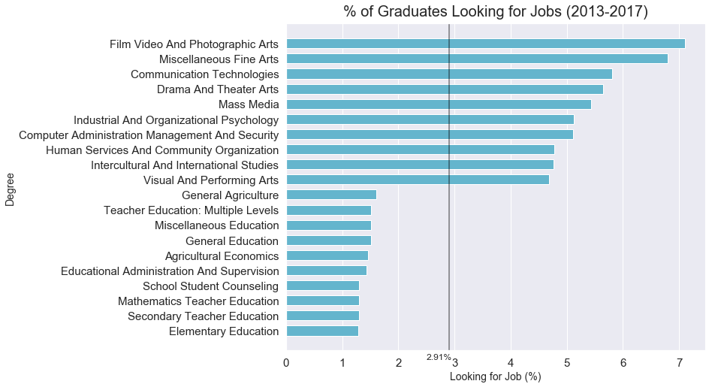

Slide 25
Analyzing the Gender Dichotomy in Post-Secondary Education and Post-Graduate Labor Force
173 degrees
Raw count of graduates in each degree
Post-graduate salaries
Calculated:
% gender in each degree
Average salaries

Slide 26
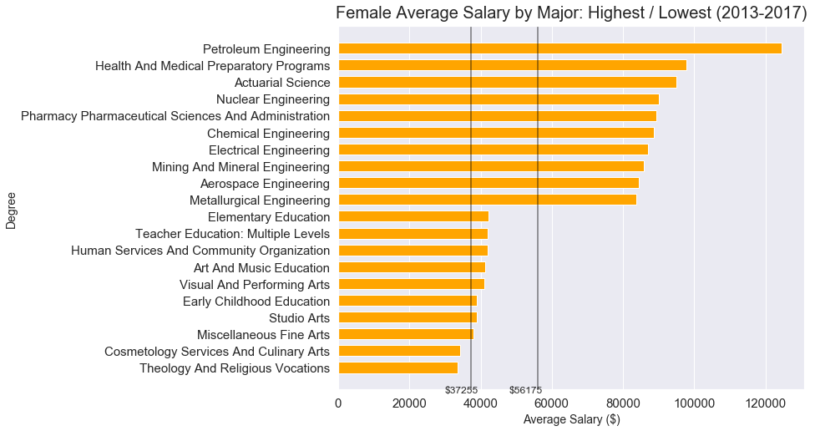

Slide 27
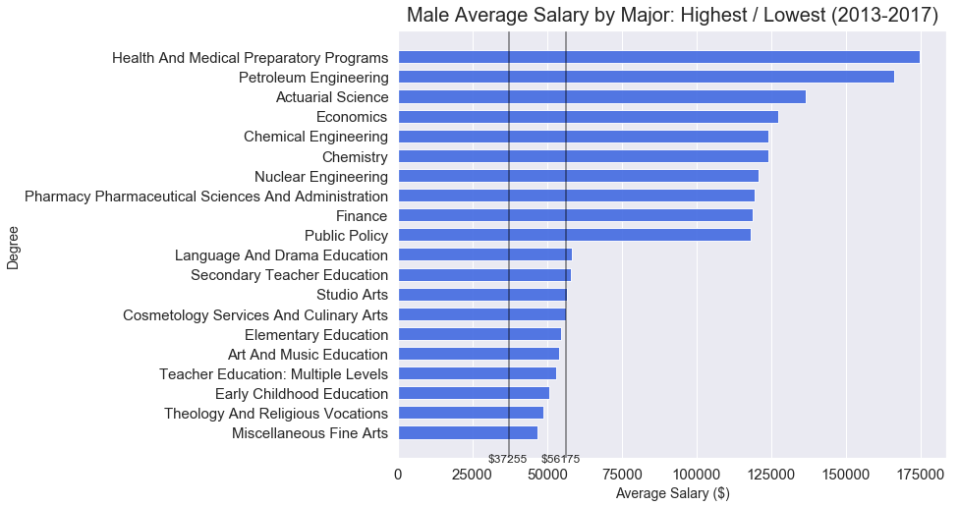

Slide 28
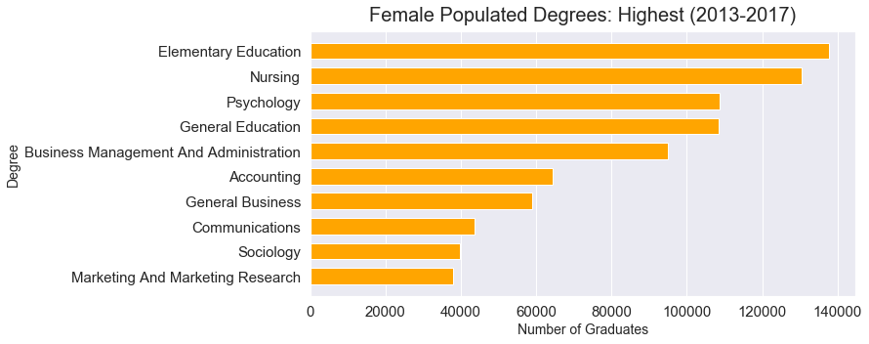

Slide 29
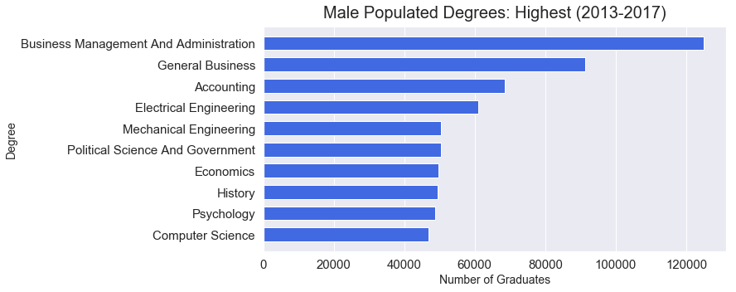

Slide 30
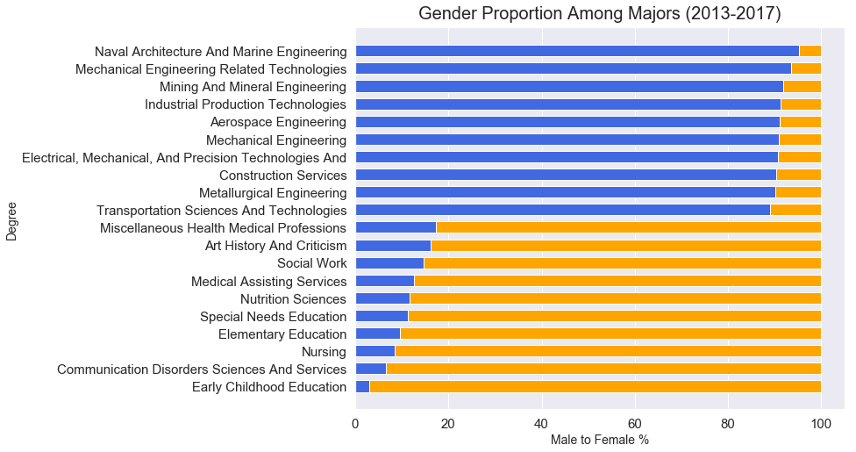
Notes:
Explain why this visualization makes more sense than Pie Chart

Slide 31
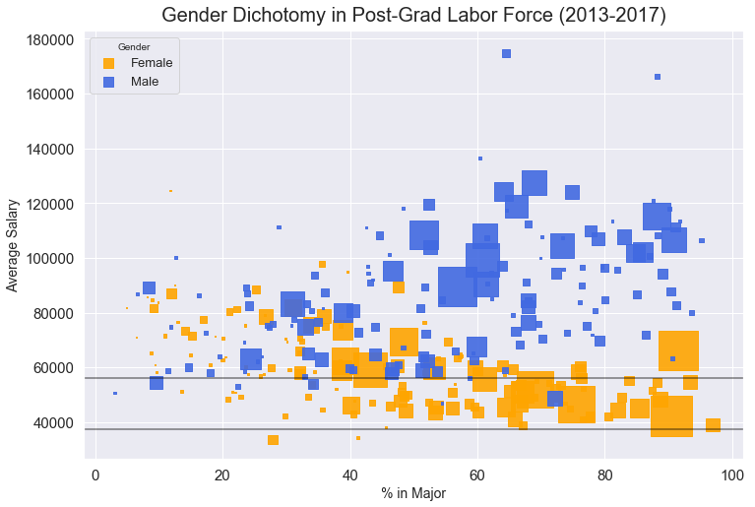

Slide 32
Discussion

Slide 33
What are our findings?
College graduates in STEM fields are the highest paid.
Education majors are paid the least
More men are in STEM related fields, while there are more women in education & nursing
College graduates with degrees in education are also most likely to make less than the US avg.
College graduates in business, psychology, and general education are most likely to work in jobs that do not require a college degree.

Slide 34
Post Mortem

Slide 35
What difficulties arose?

Slide 36
Additional questions that came up.
Extracting State data
Debt & ROI
Heat map

Slide 37
Questions?

